Slide 1
Voice Recognition using MFCC and GMM
GUIDED BY: PROF THOMAS ABRAHAM J
PRESENTED BY: SHUBHAM GUPTA (18Mca1093)

Slide 2
Content
INTRODUCTION
PROBLEM STATEMENT
TECHNOLOGY
SYSTEM ARCHITECTURE
LITERATURE REVIEW
CONCLUSION
REFERENCES

Slide 3
INTRODUCTION
Speaker Recognition is the identification of a speaker from speech features.
The difference between speaker recognition and speech recognition is that speaker recognition is recognizing who is speaking and speech recognition is recognizing what is being said.

Slide 4
Problem Statement
Ability to correctly identify the speaker of a new utterance of the same phrase.
The effects of different numbers of training samples and feature selections on performance.
Ability to correctly identify the speaker whom it is trained and also able to identify the speaker voice that is not trained.

Slide 5
TECHNOLOGY
Python 3.7
Language
Python_speech_feactures
Library
MFCC (Mel Frequency Cepstral Coefficient)
Features
Model training
GMM (Gaussian Mixture Model)

Slide 6
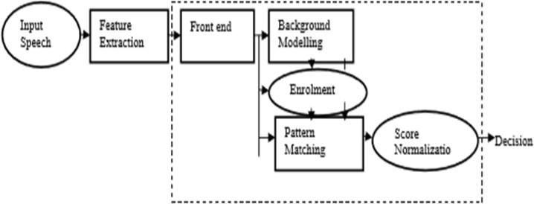
System Architecture

Slide 7
Literature I Review
New Technique to use the GMM in Speaker Recognition System by Snani Cherifa, Ramdani Messaoud
In this paper, the author describing the enhance effectiveness of GMM-based speaker recognition we propose in this article a new technique used training GMM algorithm to calculate the best number of Gaussian mixture for each speaker model, this number of mixture is fixed at the classical method in the beginning of training phase in this case all speakers have the same number of Gaussian mixture. The results obtained are compared to the classical training GMM technique, and show that the performance of the new technique is superior to the classical technique that for either the text_independent or text_dependent identification.

Slide 8
Speaker Recognition- Identifying People by their Voices by George R Doddington
The usefulness of identifying a person from the characteristics of his voice is increasing with the growing importance of automatic information processing and telecommunications. This paper reviews the voice characteristics and identification techniques used in recognizing people by their voices.
The author discussed of inherent performance limitations, along with a review of the performance achieved by listening, visual examination of spectrograms, and automatic computer techniques, attempts to provide a perspective with which to evaluate the potential of speaker recognition and productive directions for research into and application of speaker recognition technology.

Slide 9
Mel frequency Cepstral Coefficient(MFCC)
MFCC are the Mel Frequency Cepstral Coefficients.
Mel Frequency Cepstral Coefficients (MFCC) is commonly used as feature extraction technique in speech recognition system such as the system which can be automatically recognize which is the task of recognition people from their voice.
The proposed system is base on the classification of MFCC coefficients obtained from speech signals.
The developed system is consisting of three processes:
1) Features Extraction 2)Training 3)Matching

Slide 10
Features Extraction
These features are extracted from the person’s voice by using MFCC (Mel Frequency Cepstral Coefficient)
MFCC is used as the acoustic features of human voice. It considers the human voice pitch in the form of frequencies.
Mel scale, these extracted features are unique to others

Slide 11
Training
Extracted features from MFCC are trained using GMM (Gaussian Mixture Model).
Expectation Maximization (EM) algorithm is used train the extracted features of human voice in system and then finally used to store in database.

Slide 12
Matching
In matching process the system authenticate the registered person by matching the current voice sample to the stored voice samples in the database. It recalculates the log probability of voice and compares it to previously stored value. The log probability equal to the stored value provides access to the entire speaker.

Slide 13
Gaussian Mixture Model (GMM)
A Gaussian mixture model is a probabilistic model that assumes all the data points are generated from a mixture of a finite number of Gaussian distributions with unknown parameters. One can think of mixture models as generalizing k-means clustering to incorporate information about the covariance structure of the data as well as the centers of the latent Gaussians. Speaker database: The speaker models are stored here. Decision logic: It makes the final decision about the identity of the speaker

Slide 14
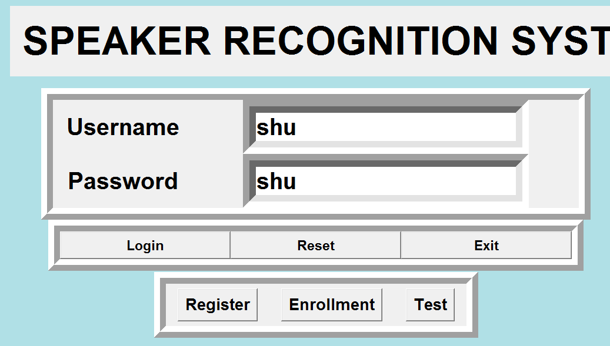
GUI Speaker Recognition System

Slide 15
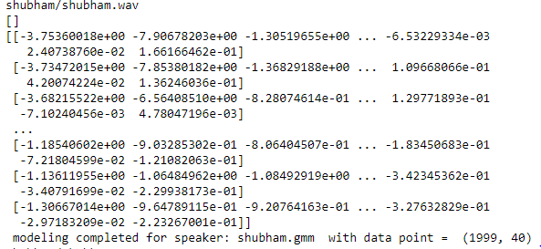
Model Training

Slide 16
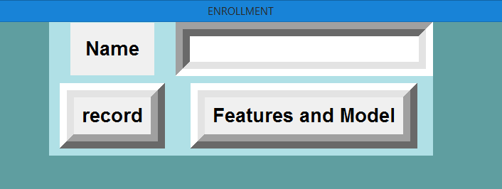
GUI Enrolment

Slide 17
Perform Recognition
The log-likelihood for each .gmm model of every speaker was calculated in the model training phase. It was stored as a database in a separate folder.
This data dictionary is used for matching 1: N speaker’s gmm file.
The speaker with the highest score is chosen and identified

Slide 18
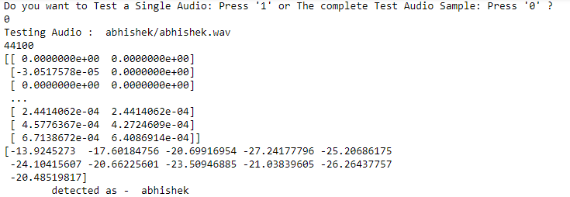
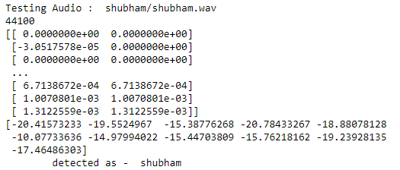
Perform Recognition

Slide 19
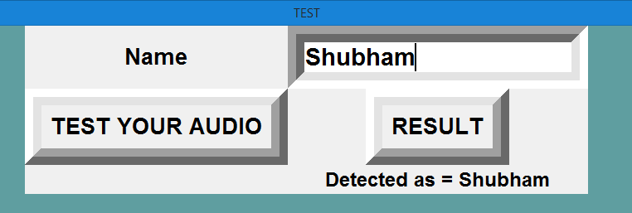
Perform Recognition

Slide 20
CONCLUSION
The speaker recognition that includes various methods of features extraction and model training mainly focused on MFCC and GMM. Recognition of speakers is a multidisciplinary biometrics branch that can be used to classify and validate speakers to protect sensitive information

Slide 21
References
[1] George R Doddington, Member, IEEE, “Speaker Recognition- Identifying People by their Voices”, proceedings of the IEEE, Vol. 73, no. 11, pp. 16511664, November 1985.
[2] Richard D. Peacocke, and Daryl H. Graf, “An Introduction to Speech and Speaker Recognition “, IEEE, pp. 26-33, August 1990.
[3] Tomi kinnunen, Haizhou Li, “An overview of text-independent speaker recognition: From features to supervectors”, Speech Communication 52, pp. 12-40, 2010.
[4] Ling Feng , Kgs. Lyngby “Speaker Recognition”, Thesis, Technical University of Denmark Informatics and Mathematical Modeling, Denmark, 2004.
[5] J. Wu and J. Yu, "An improved arithmetic of MFCC in speech recognition system," in Electronics, Communications and Control (ICECC), 2011 International Conference on, 2011, pp. 719-722
[6] Yingjie He, Liwei Ding, Yuxian Gong, Yongjin Wang,“Real-time Audio & Video Transmission System Based on Visible Light Communication ”,June 2013.

Slide 22
Thank You

